Slide 1
RT distribution, test block design, instructions, and Spanish context setup
Jun 9, 2026

Slide 2
2026/06/05 updates
Full dataset: N=30
Revisit data exclusion criteria
Participant-level exclusion: low accuracy in catch trials (N=2), over 15% trials with RTs < 200ms (N=4), flat categorization curve (N=1), RT +-3D from group mean (N=0)
Trial-level exclusion: RT<200ms or >3000ms (303 trials), RT +-3SD within participant (34 trials)
Total number of trials after exclusion: 6015 trials from 23 participants

Slide 3
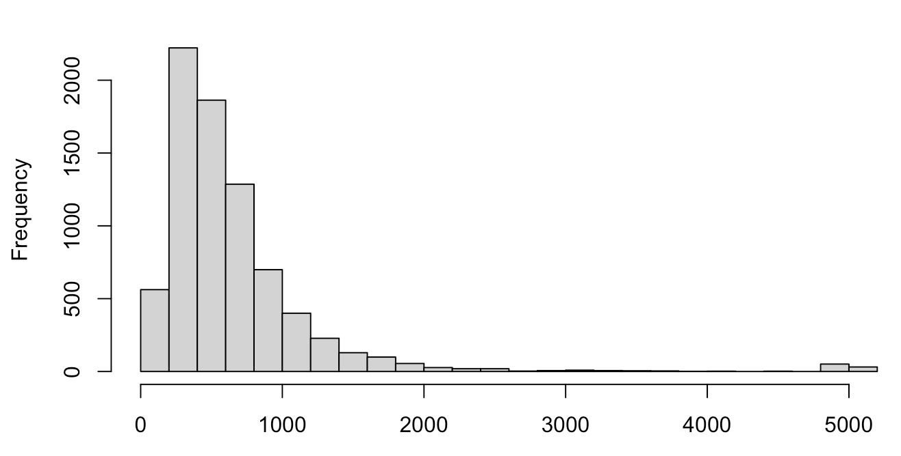
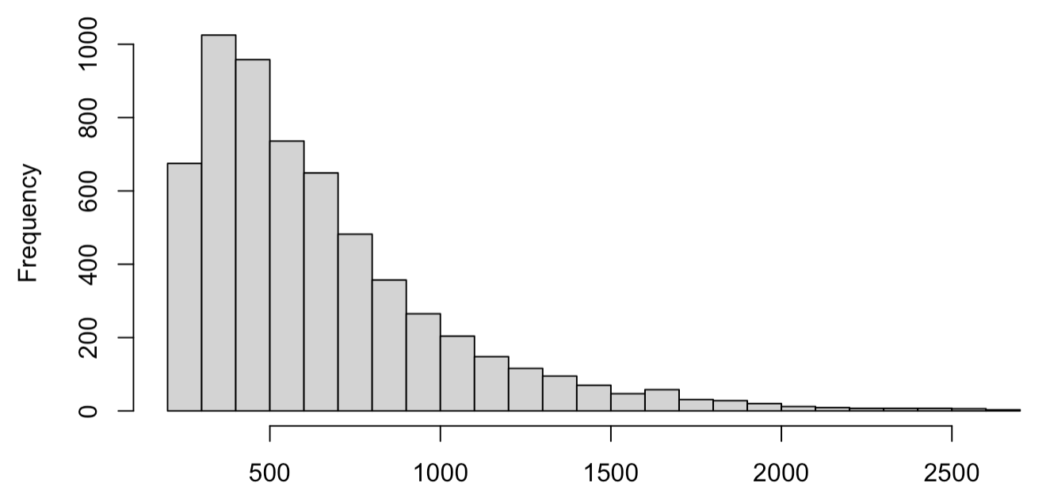
Raw RT data distribution
Before data exclusion
After data exclusion

Slide 4
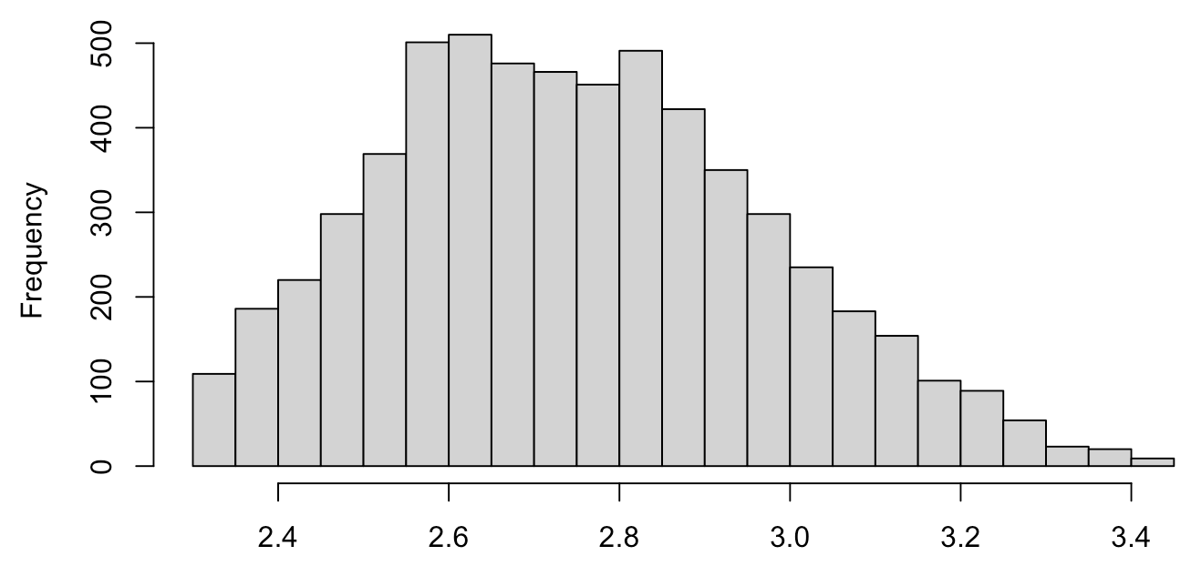
Log RT data distribution after data exclusion

Slide 5
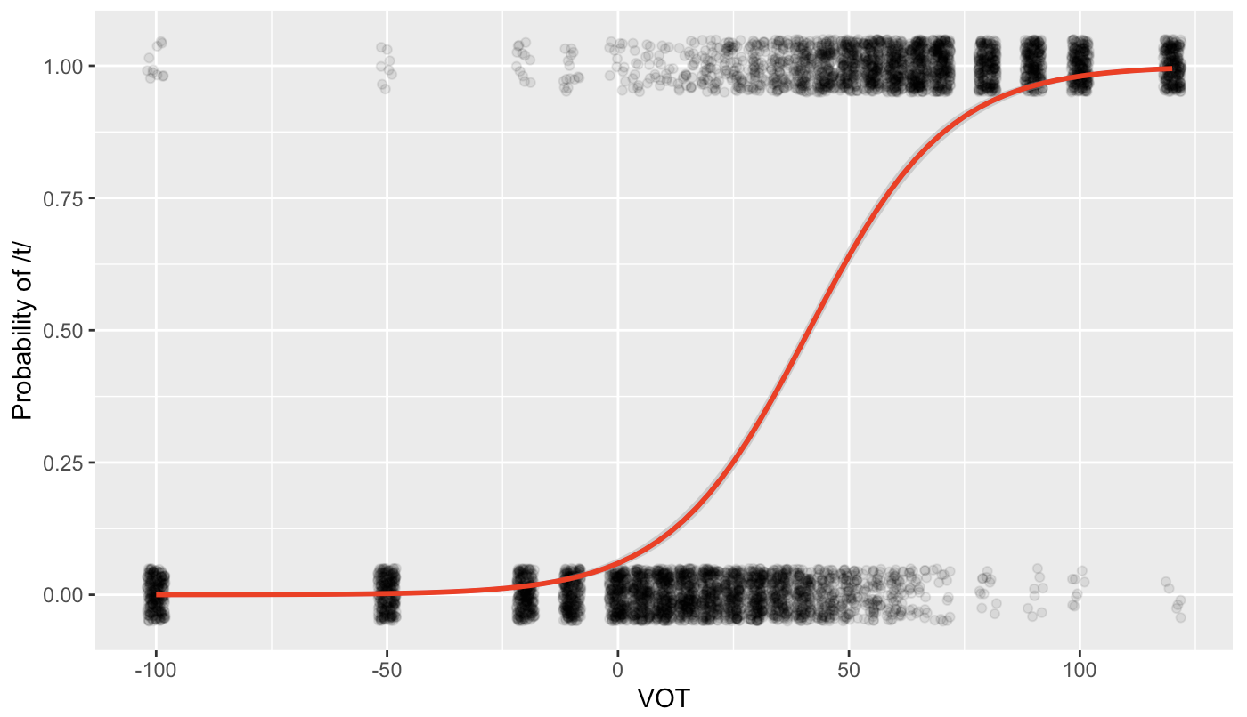
Group level results aggregated over word pairs
42.24657ms

Slide 6
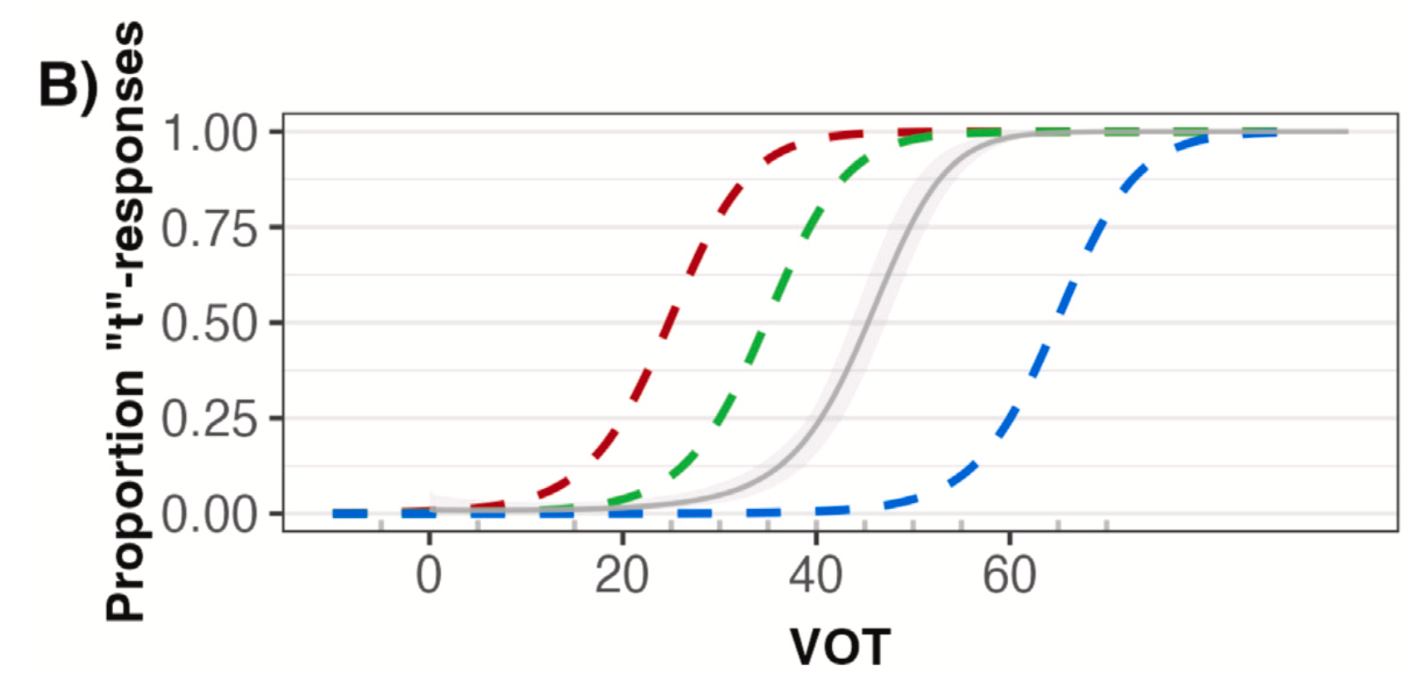
Model prediction from Tan & Jaeger (2025)

Slide 7
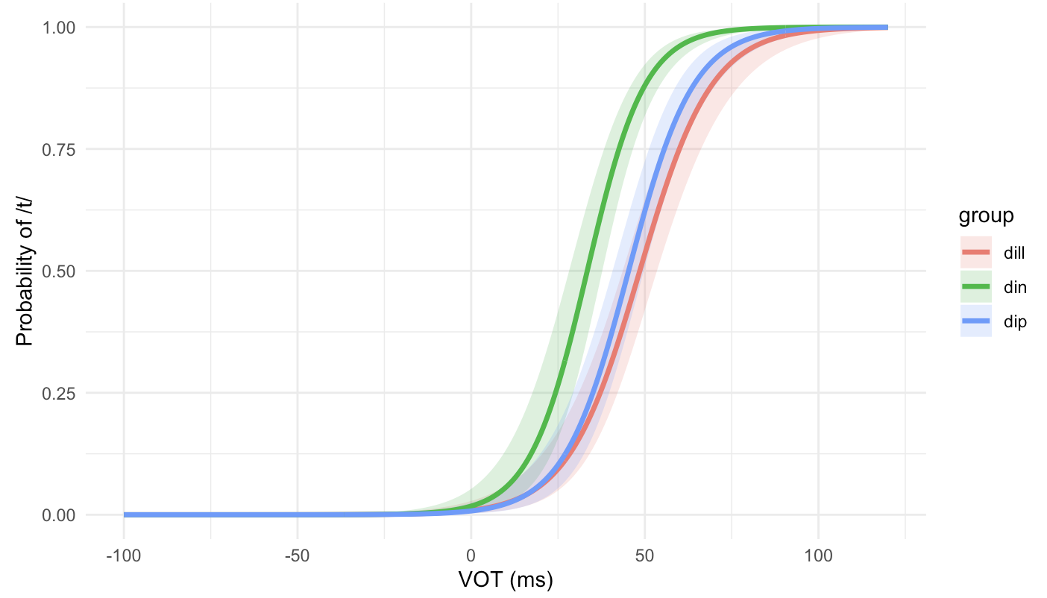
Group level results by different word pairs
dip: 45.32ms
din: 33.42ms
dill: 48.54ms

Slide 8
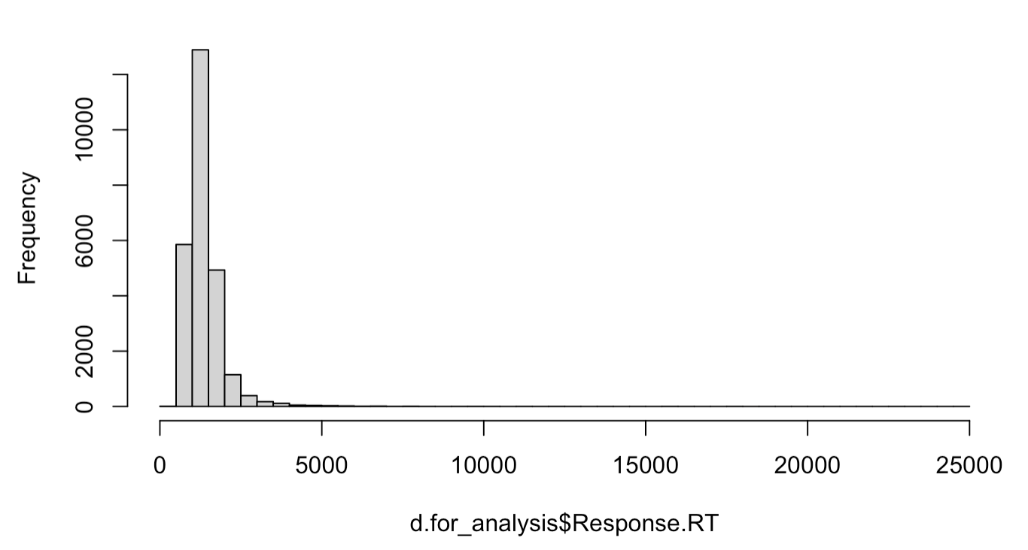
RT distribution in Tan & Jaeger (2025)
N=25704
RT > 3000ms: 480/25704 (1.86%)
RT < 200ms: 0%

Slide 9
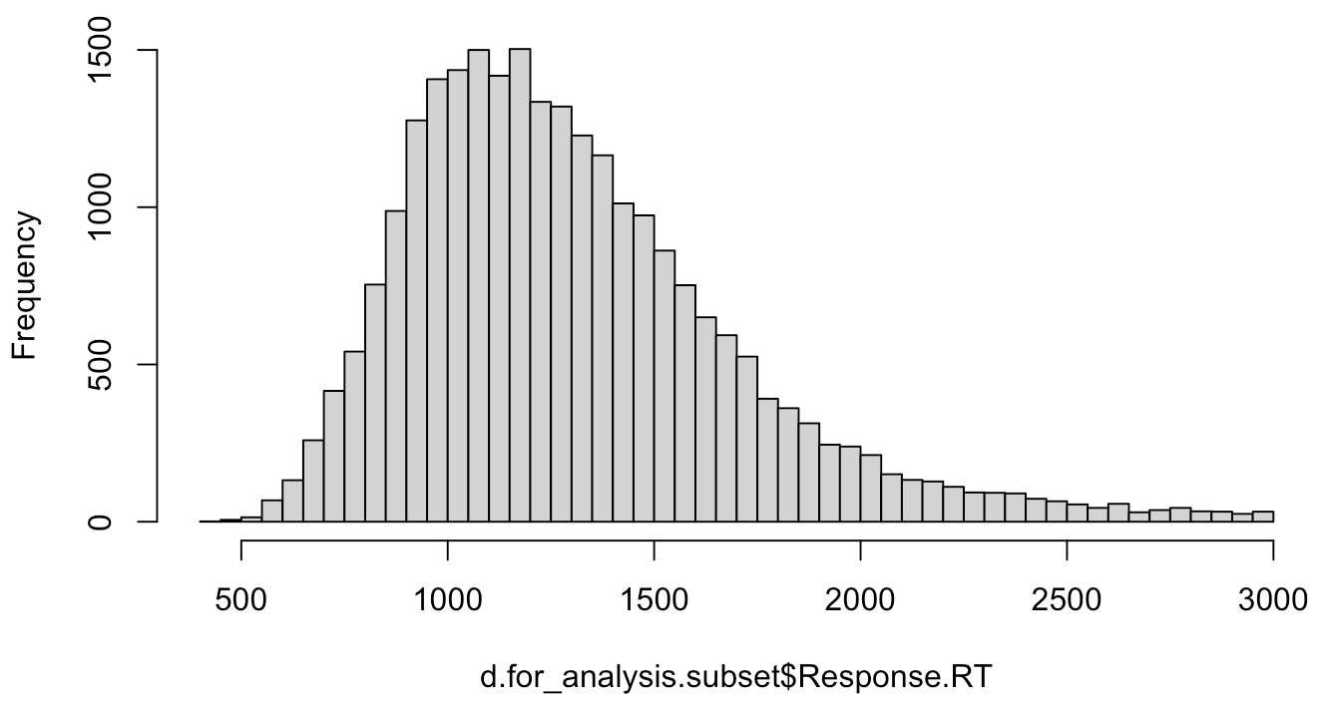
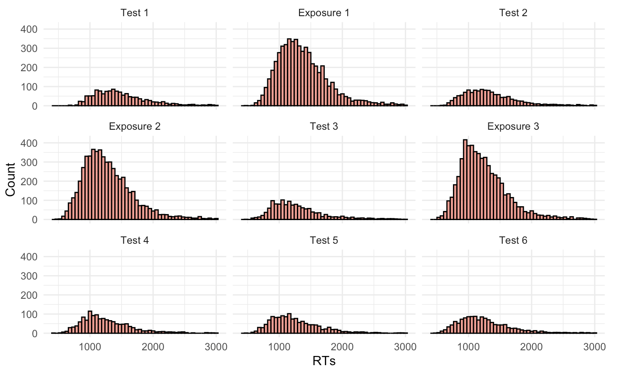
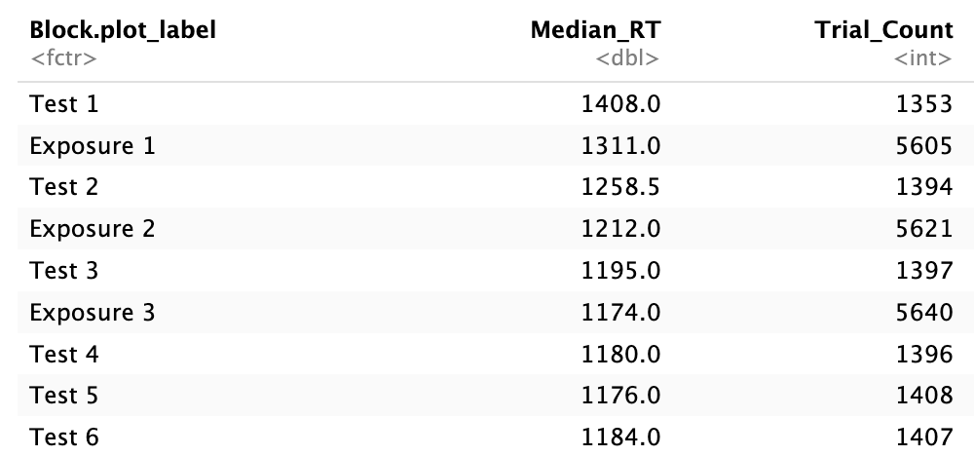
RT distribution in Tan & Jaeger (2025)

Slide 10
Decision on timeout limit
Instruction: respond as quickly and accurately as possible
Set up 5 second response window
Exclude RTs<200ms or RTs>3000
Exclude participant-level and trial-level outliers (+-3SD)

Slide 11
Test blocks design
Create 18 lists based on the counterbalancing constrainsts in TJ2025
72 tokens (3 continuum x 12 VOT step x 2 rep) - distributed across 6 test blocks
each block contain all 12 VOT steps
(2) tokens from each of the three continua occur equally frequently within block (four tokens from each continuum)
(3) the exact same token appears no more than once within block

Slide 12
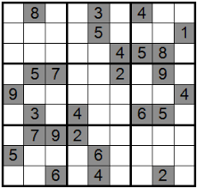
Test blocks design
 | -5 | 5 | 15 | 25 | 30 | 35 | 40 | 45 | 50 | 55 | 65 | 70
block1 | dill | dip | din | dill | dip | din | dill | dip | din | dill | dip | din
block2 | dip | din | dill | din | dill | dip | din | dill | dip | dip | din | dill
block3 | din | dill | dip | dip | din | dill | dip | din | dill | din | dill | dip

Slide 13

Test blocks design
 | -5 | 5 | 15 | 25 | 30 | 35 | 40 | 45 | 50 | 55 | 65 | 70
block1 | dill | dip | din | dill | dip | din | dill | dip | din | dill | dip | din
block2 | dip | din | dill | din | dill | dip | din | dill | dip | dip | din | dill
block3 | din | dill | dip | dip | din | dill | dip | din | dill | din | dill | dip

Slide 14
Test blocks design
 | -5 | 5 | 15 | 25 | 30 | 35 | 40 | 45 | 50 | 55 | 65 | 70
block1 | dill | dip | din | dill | dip | din | dill | dip | din | dill | dip | din
block2 | dip | din | dill | din | dill | dip | din | dill | dip | dip | din | dill
block3 | din | dill | dip | dip | din | dill | dip | din | dill | din | dill | dip

Slide 15
Test blocks design
 | -5 | 5 | 15 | 25 | 30 | 35 | 40 | 45 | 50 | 55 | 65 | 70
block1 | dill | dip | din | dill | dip | din | dill | dip | din | dill | dip | din
block2 | dip | din | dill | din | dill | dip | din | dill | dip | dip | din | dill
block3 | din | dill | dip | dip | din | dill | dip | din | dill | din | dill | dip

Slide 16
Test blocks design
 | -5 | 5 | 15 | 25 | 30 | 35 | 40 | 45 | 50 | 55 | 65 | 70
block1 | dill | dip | din | dill | dip | din | dill | dip | din | dill | dip | din
block2 | dip | din | dill | din | dill | dip | din | dill | dip | dip | din | dill
block3 | din | dill | dip | dip | din | dill | dip | din | dill | din | dill | dip

Slide 17
Test blocks design
 | -5 | 5 | 15 | 25 | 30 | 35 | 40 | 45 | 50 | 55 | 65 | 70
block1 | dill | dip | din | dill | dip | din | dill | dip | din | dill | dip | din
block2 | dip | din | dill | din | dill | dip | din | dill | dip | dip | din | dill
block3 | din | dill | dip | dip | din | dill | dip | din | dill | din | dill | dip
 | -5 | 5 | 15 | 25 | 30 | 35 | 40 | 45 | 50 | 55 | 65 | 70
block4 | dill | dip | din | dill | dip | din | dill | dip | din | dill | dip | din
block5 | dip | din | dill | din | dill | dip | din | dill | dip | dip | din | dill
block6 | din | dill | dip | dip | din | dill | dip | din | dill | din | dill | dip

Slide 18
Decision on test block design
Pre-compiled 18 versions of lists conforming to the counterbalancing constraints, along with within-block randomization on gorilla?

Slide 19
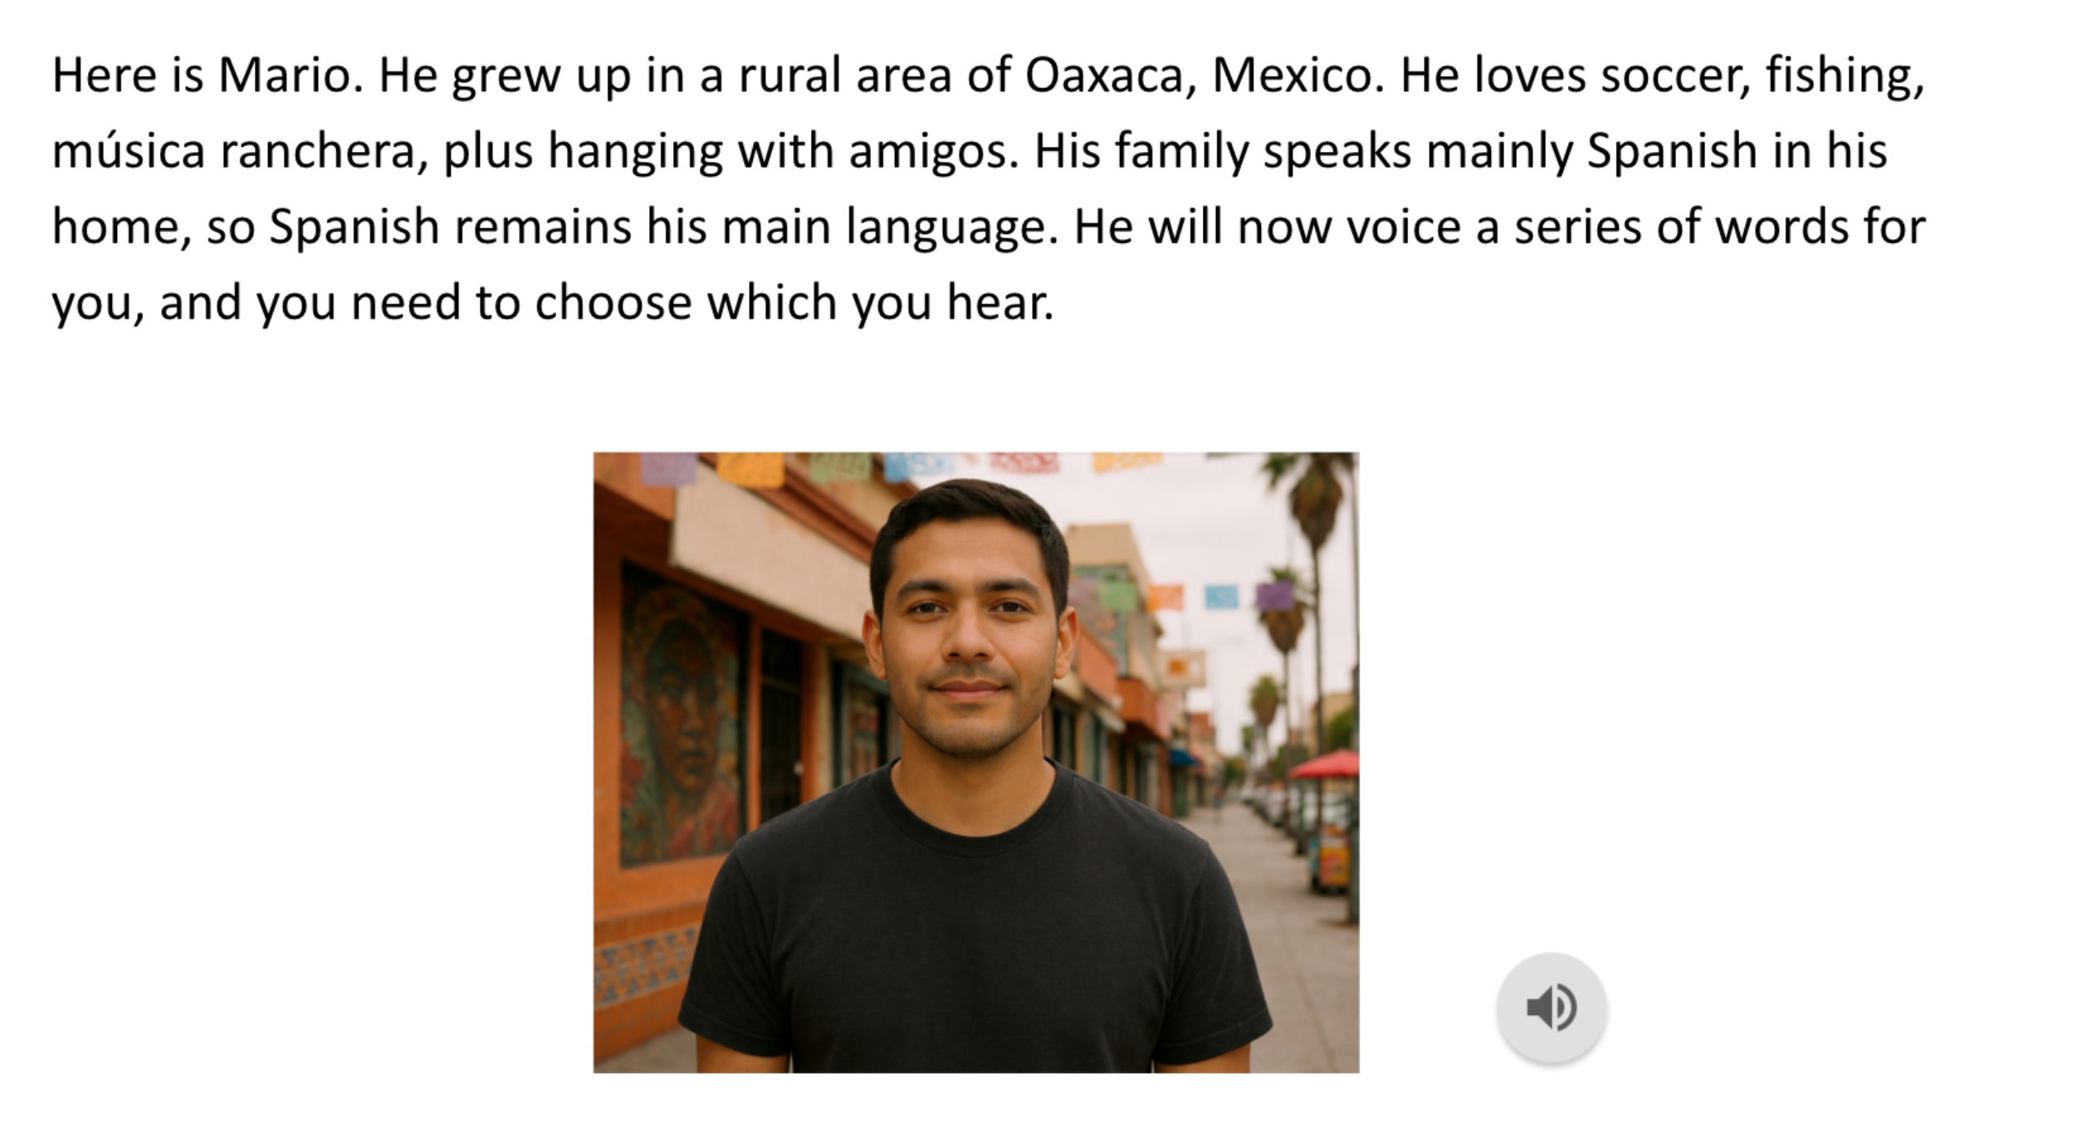
Spanish instruction
Avoid /d/, /t/
Keep it short
Third person perspective
And no audio?

Slide 20
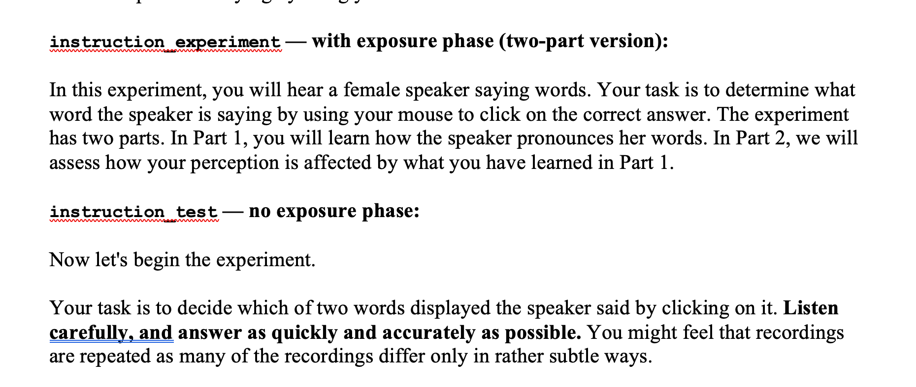
General instruction
ask participants to respond quickly and accurately

Slide 21
To-dos:
Finalize counterbalancing stimuli lists
Finalize Spanish context materials
Gorilla setup (earphone screening, Spanish context setup, instruction, practice, exposure, test, break, post-test questionnaire)

